Slide 1
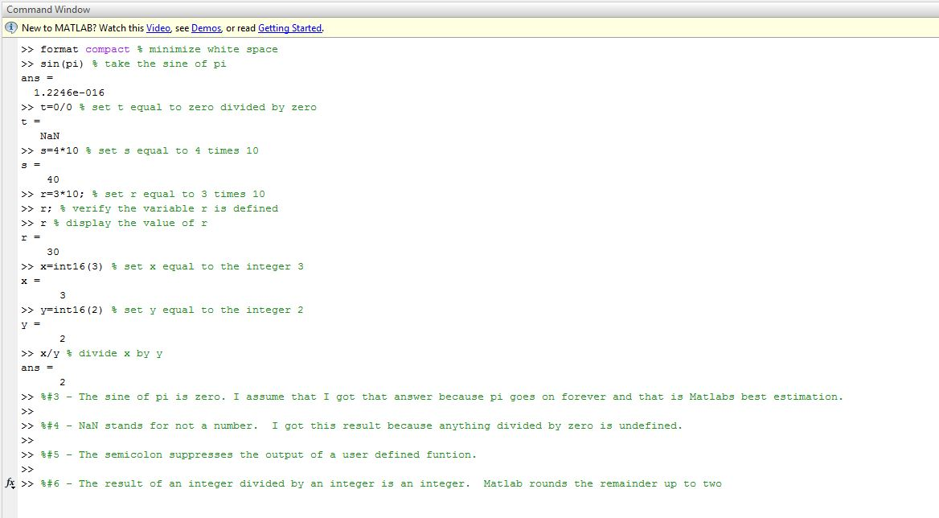
ECE 101 Matlab Assignment #3
Ryan M Fenn
Due September 28, 2011

